Slide 1
Logistic Regression Analysis of Categorical outcome data
Moses Ngari

Slide 2
Logistic Regression
Objectives
Use a logistic model to compare the log odds of disease (or any binary outcome variable) in two groups
Use a logistic model to compare the odds of an outcome for a categorical exposure with 2 or more levels and to estimate crude odds ratios associated with each level.
Understand statistical tests of the null hypothesis - there is no association between the exposure and outcome
1 using the Wald test
2 using the Likelihood Ratio Test
4 Models with more than one explanatory variable

Slide 3
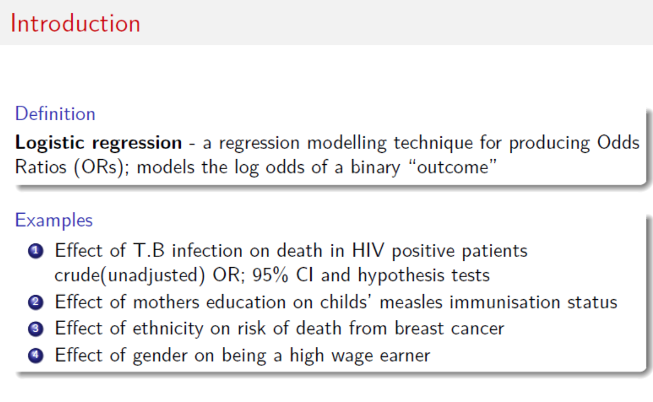

Slide 4
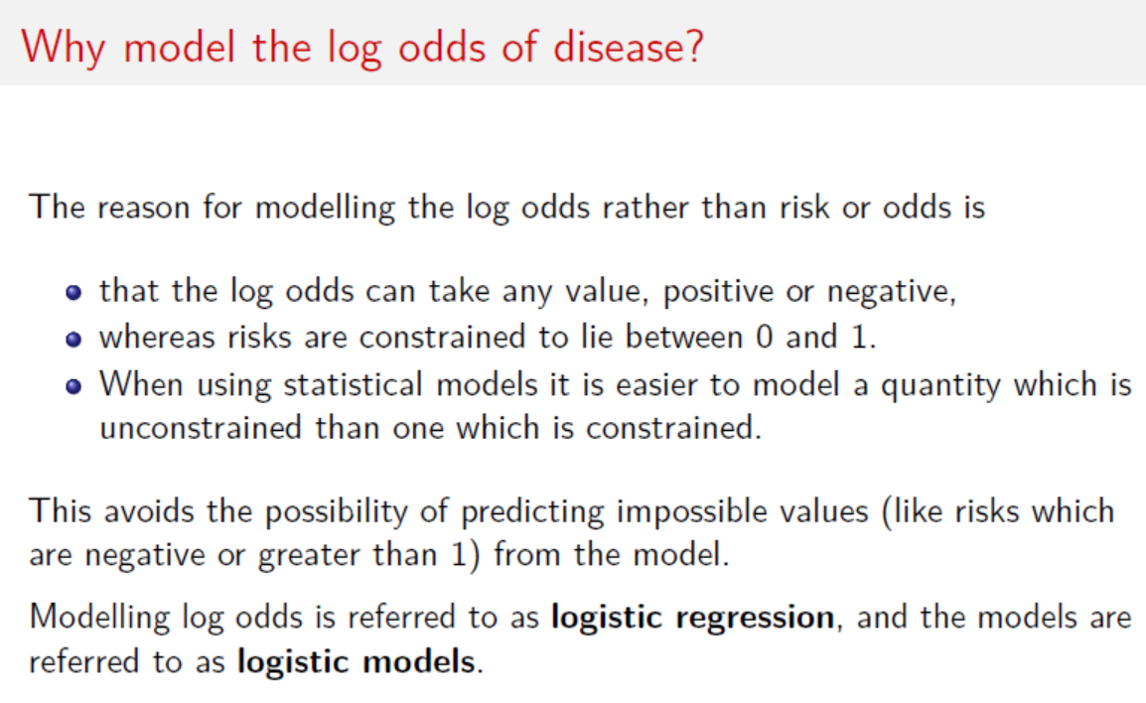

Slide 5
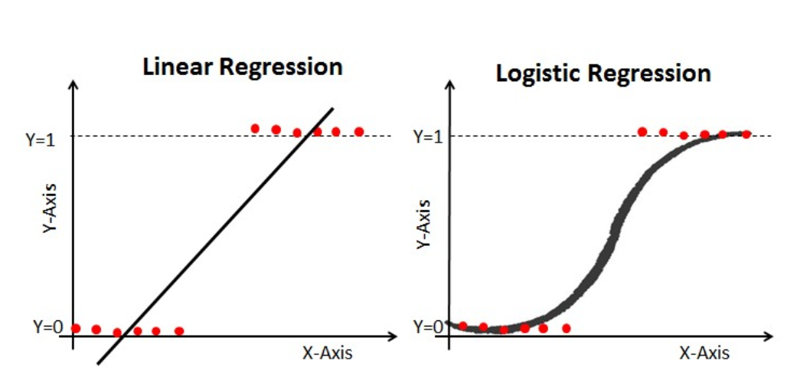

Slide 6
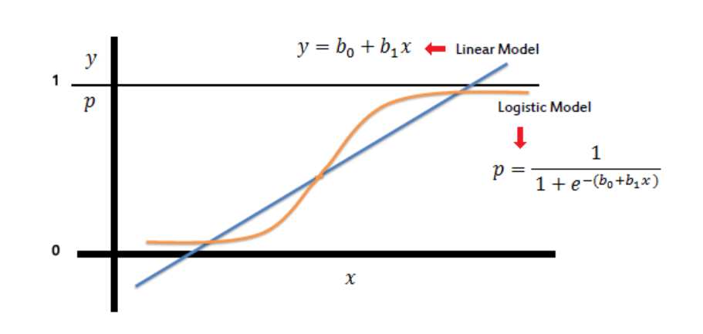

Slide 7
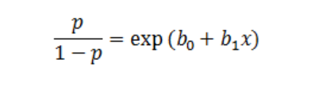
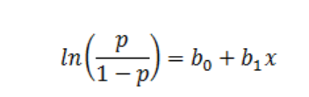
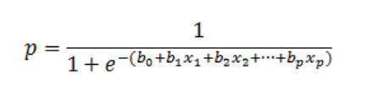

Slide 8
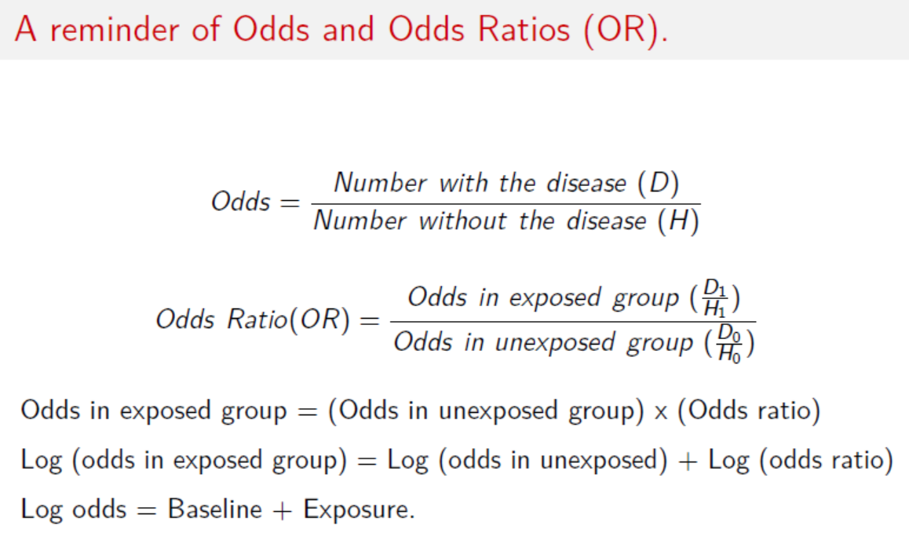

Slide 9
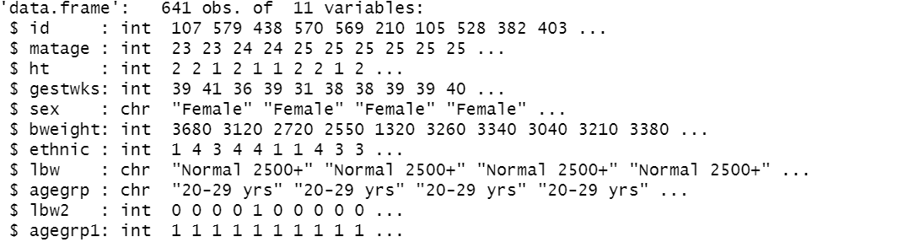
Example
Use the birthweight2.csv dataset.
Objective: What factors are associated with lbw2?

Slide 10
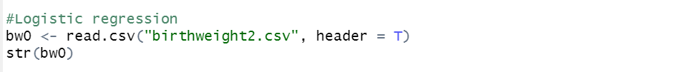

Slide 11
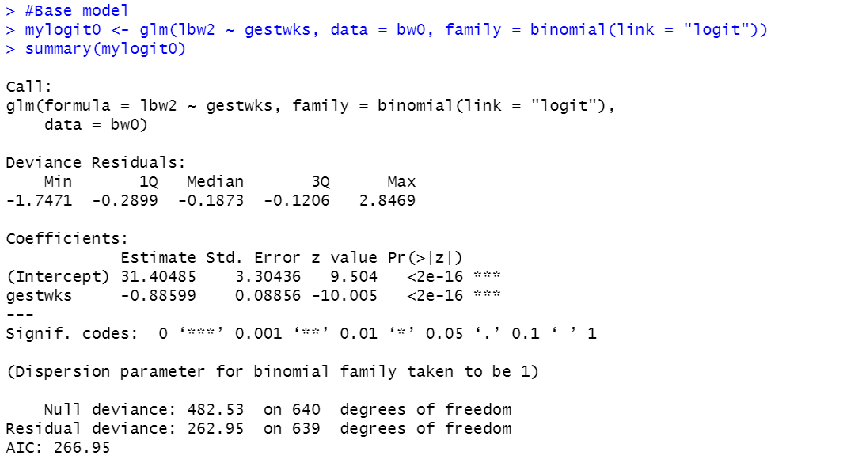
Univariate analysis

Slide 12
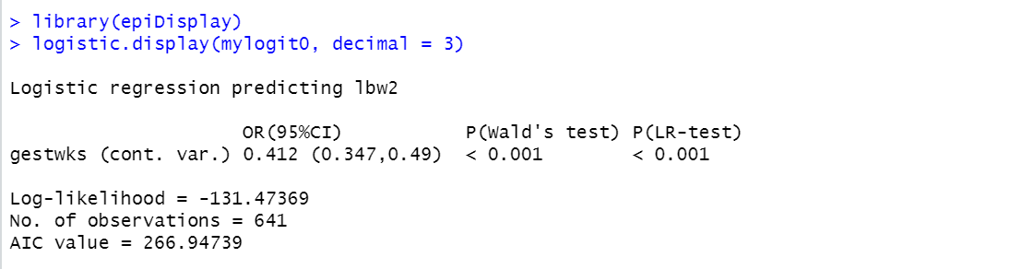

Slide 13
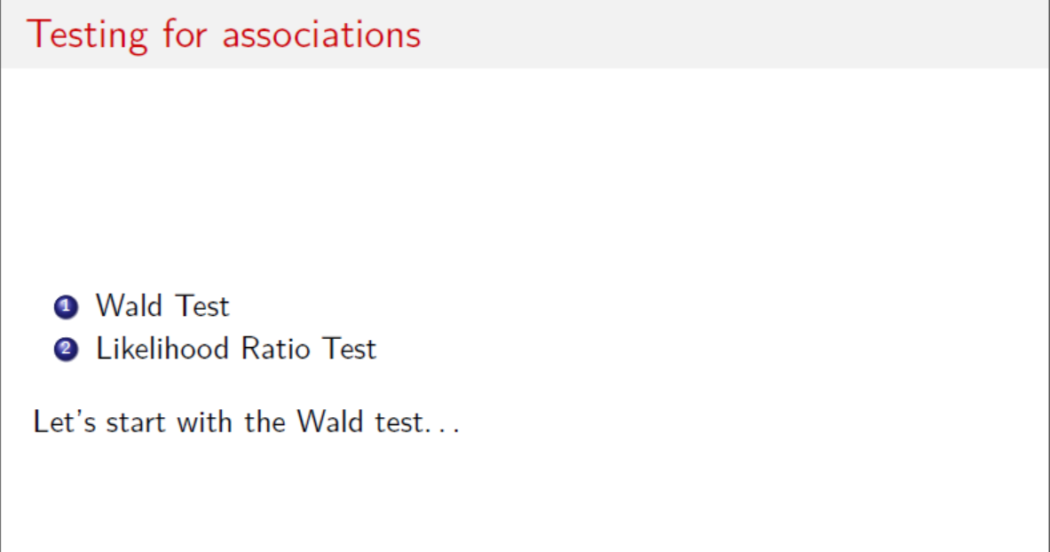

Slide 14
Wald test
The null hypothesis for this test is that the true parameter (logOR) value is 0.
The test statistic (z) is obtained by dividing the parameter estimate by its SE and comparing it with a Standard Normal distribution.
The Wald test for `gestwks’ assesses the H0 that the true log OR=0
(i.e. that the true OR is 1) versus the alternative that the true log OR is not 0.

Slide 15
The Likelihood ratio test
The Likelihood Ratio Test (LRT) is based on the Likelihood Ratio Statistic (LRS): LRS=2(L1-L0); where
L1 is the maximised log likelihood under the alternative hypothesis, ie different odds of disease in each group
L0 is the log likelihood under the null hypothesis ie one with no age effect included

Slide 16
Wald test
The Wald test for the association between LBW2 and `gestwks’ is given by: z = log(OR)/SE(logOR) =
-0.88559/0.08856 = -10.005
The corresponding p-value is small (p=2e-16), indicating strong evidence against the null hypothesis of no association between LBW2 and `gestwks’.
The crude OR is 0.412 (95%CI 0.347 to 0.49) meaning, for every increase in `gestwks’, the odds of LBW reduces by 58%.
Note the 95%CI doesn’t contain 1.

Slide 17
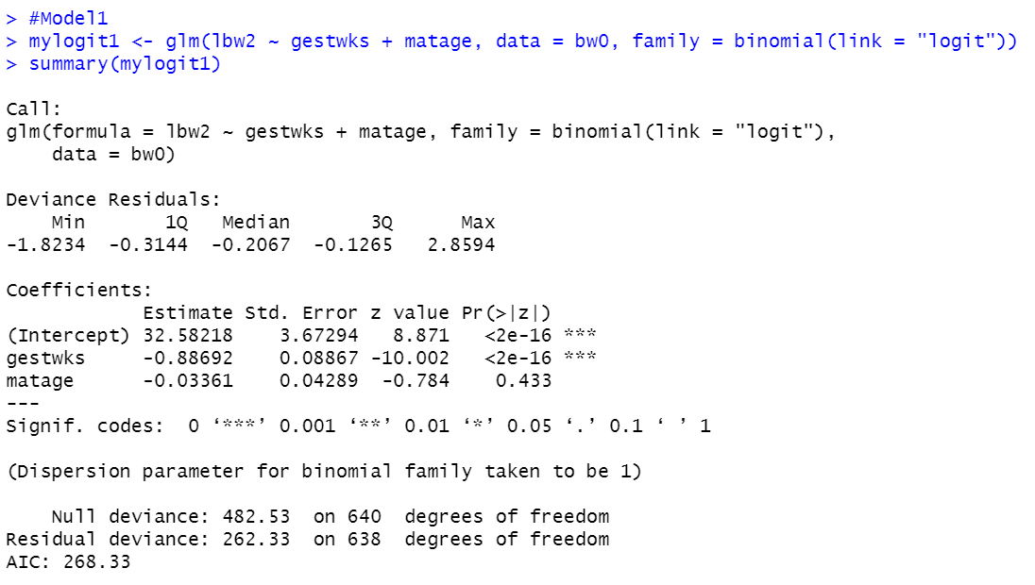
Multiple logistic regression analysis

Slide 18
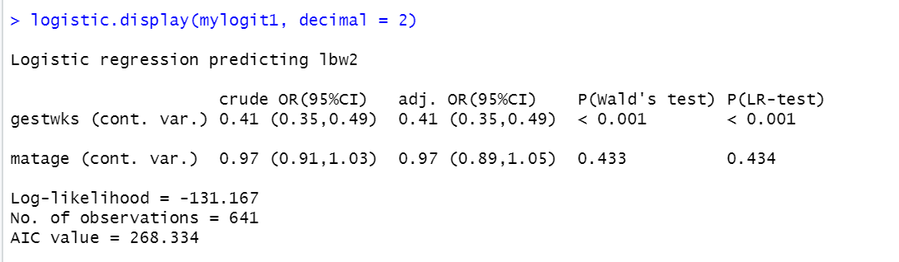

Slide 19
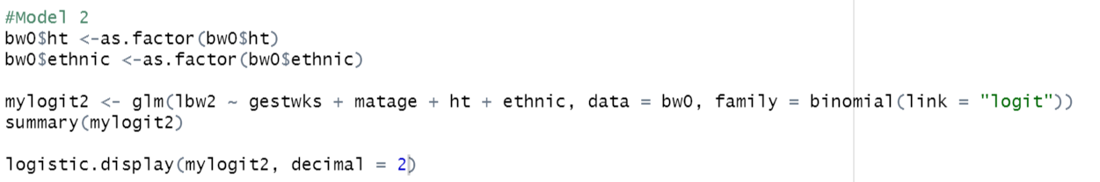

Slide 20
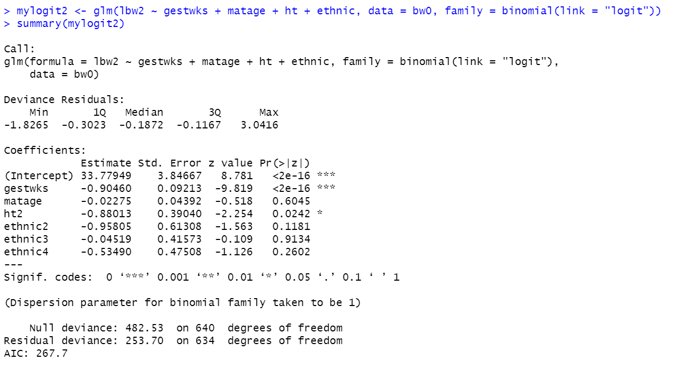

Slide 21
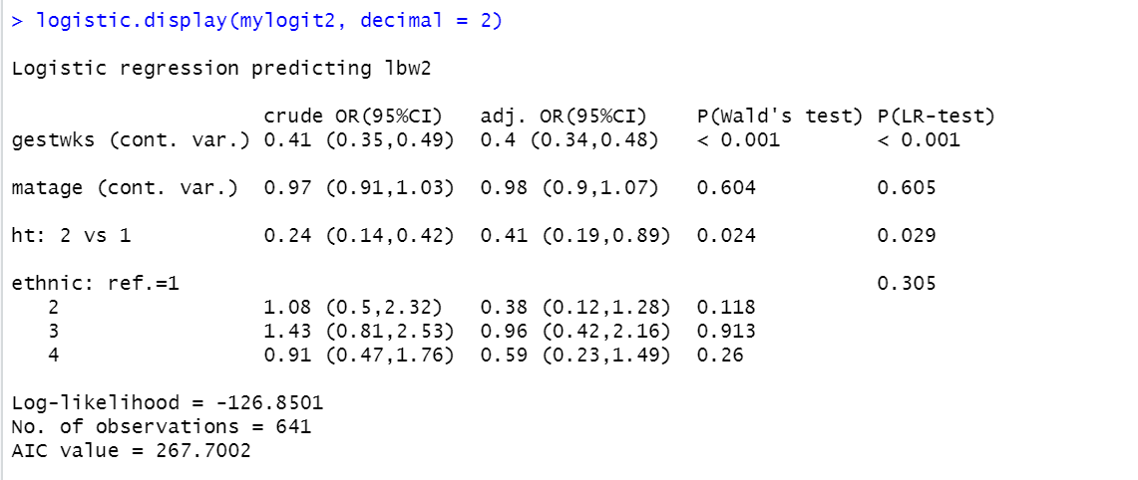

Slide 22
